Slide 1

Symmetric key
Identification

Slide 2
Model
Client and Server share key
Out of band key distribution
Examples
Passwords
SIM-card keys
Keys in networked devices with single authority

Slide 3
Protocols
Basic protocol
Send identifier and password
Challenge-response protocol
Assistance by Public-key methods

Slide 4
Attacks I
Acquiring credentials
Useful against
Plaintext keys
Encrypted stored keys (if also acquires the storage key)
Hashed passwords

Slide 5
Attacks II
Eavesdropping
Useful against
Basic protocol
Challenge-response with weak passwords/keys
Man-in-the-middle
Useful against
Plaintext traffic after identification

Slide 6
Man-in-the-Middle + CR
Server
MITM
Client
U
User: U
Key: K
User | Key
U₁ | K₁
U₂ | K₂
… | …
U_{n} | K_{n}
Random challenge r
Response: MAC_{K}(r)
Access granted

Slide 7
Protecting against MITM
Client and server share key K
Phase I – challenge-response authentication
Phase II –
Hash (key, challenge) = session keys
Session keys: key for encryption, key for integrity
Protect traffic with session keys

Slide 8
Symmetric key
Split Servers

Slide 9
Model
Authentication server holds client’s credentials
Operational server
Provides service
Example – roaming in mobile network
Home network = authentication server
Visited network = operational server

Slide 10
Alternatives I
Option I
Operational Server acts as router for
Client-Authentication Server communication
Option II
Client authenticates to Authentication Server
Receives “token” known to Op. Server
Uses Token to authenticate

Slide 11
Alternatives II
Option III
Auth. Server provides material for challenge response
Used in roaming for mobile networks

Slide 12
Split Servers
Authentication Server
Operational Server
Client
U
U
User: U
Key: K
User | Key
U₁ | K₁
U₂ | K₂
… | …
U_{n} | K_{n}
Random r, s=h(K,r)
r, MAC_{K}(r),s
r
MAC_{K}(r)
Traffic encrypted by s

Slide 13
Public key
Identification

Slide 14
Overview
Client (authenticator)
Private key
Server (Verifier)
Public key
Main authentication protocol
Challenge-response

Slide 15
Public Key + CR
Server
Client
Username: U
Private key: Priv
Username | Public key
U₁ | Pub₁
U₂ | Pub₂
… | …
U_{n} | Pub_{n}
U
Search U
Random challenge r
Response: Sig_{priv}(r)
Access granted

Slide 16
PKI I
Public Key Infrastructure
Every party has a public key
Pairs of (identity, public key) are public
Authentication is easy
Digital signatures are easy
Problem – initial authentication
Who verifies correct pairing (identity, public key) ?

Slide 17
Trusted Parties I
Common solution
Trusted party
Vouches for client’s public key
“Real world” trusted parties
Branches of the government
Banks, credit card companies
Trust imparted by written documents

Slide 18
Trusted Parties II
“Digital” trusted parties
Certificate Authorities (CA)
CA can be
Company / branch pf government
Trust imparted by
Certificate

Slide 19
Certificates
Data on certificate subject
Identity of subject
Public key of subject
Additional information
Example: validity period
Signature
By CA private key

Slide 20
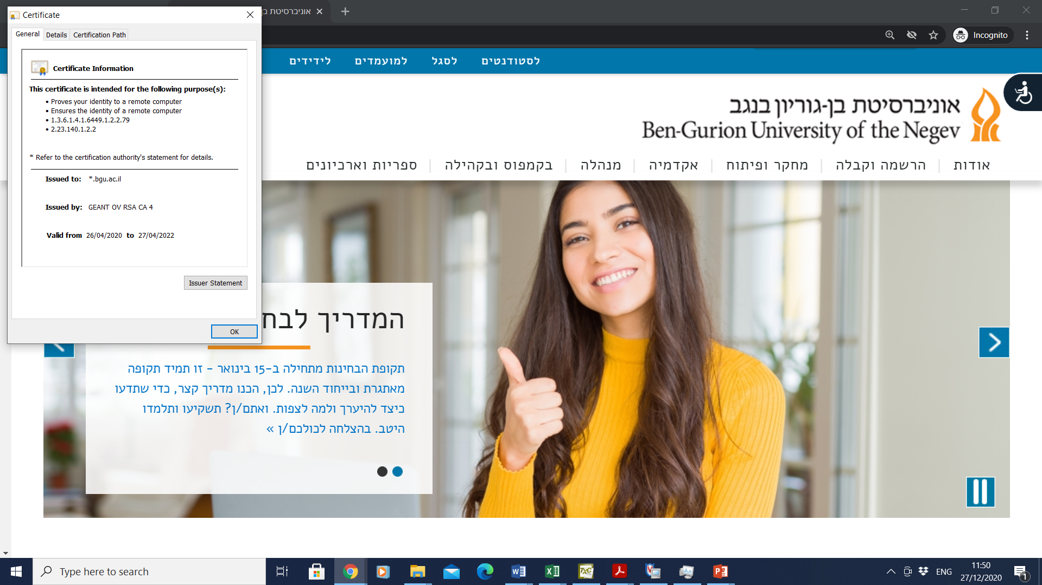
Certificate Example I

Slide 21
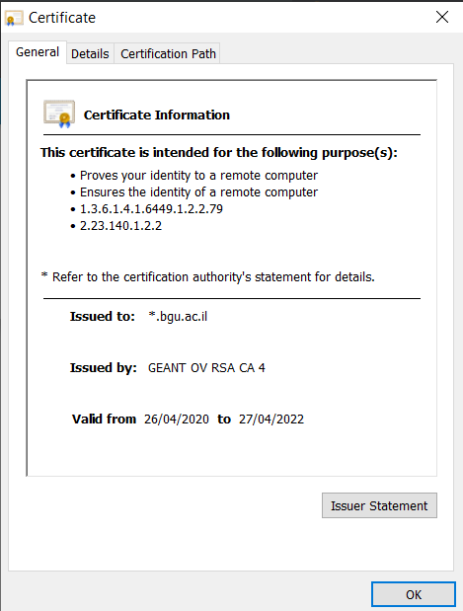
Certificate Example II
Certificate subject
Certificate Authority
Validity Period

Slide 22
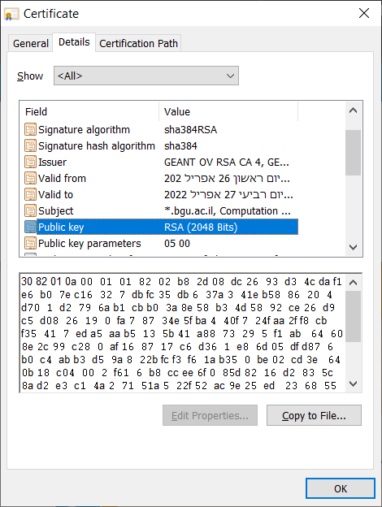
Certificate Example III
Signature on m:
[SHA384(m)]^{d} mod n
CA
Subject
Public key in ASN.1 format

Slide 23
CA Hierarchy I
What if Alice and Bob do not trust same CA?
Solution
Higher level CA!
➔ Tree of trust
Each node is CA
Each CA signs certificates of children

Slide 24
CA Hierarchy II
Three types of nodes in tree
End entities
Not allowed to sign other certificates
Example: web servers
Intermediate CA
Can sign certificates
Own certificate signed by higher level CA

Slide 25
CA Hierarchy III / PKI II
Root CA
Self-signed certificate
All parties in system know root CA public key
PKI includes
Public & Private key pair for every party
Root CA keys known to all parties
Public key and identity signed by CA
Path in trust tree from every certificate to root CA

Slide 26
PKI Single Root
Signatures using private key
Root CA
Example: Cable modem PKI.
Root CA – CableLabs
Intermediate CA – vendors
End entity – CM / CMTS
Certificate
Priv. key
Intermediate CA
Certificate
Priv. key
End entity
Sign challenges
Certificate
Priv. key

Slide 27
PKI Multiple Roots
Root CA₁
Root CA₂
Certificate
Priv. key
Certificate
Priv. key
Example: Web
End entities – web servers
Intermediate CA₁
Intermediate CA₂
Certificate chain for every end entity
Certificate
Priv. key
Certificate
Priv. key
End entity₁
End entity₂
Certificate
Priv. key
Certificate
Priv. key
Sign challenges
Sign challenges

Slide 28
CRL
Certificate Revocation List
List of invalid certificates
Maintained by CA
Signed by CA!
Can be downloaded and checked for authentication

Slide 29
Public Key Authentication
Verifier
Authenticator
Certificate chain
Cert. chain
Private key: Priv
Root CA List
Root CA₁
Root CA_{n}
Validate cert. chain
Validate each cert.
Random challenge r
Response: Sig_{priv}(r)
Key exchange

Slide 30
Certificate Chain Validation
Does chain contain root certificate?
Is root certificate in stored list?
Does chain contain end entity certificate?
Is subject name the expected name?
Is each signature in chain verified by pub. key in previous certificate in chain?

Slide 31
Certificate Validation
Is validity period acceptable?
Is certificate in CRL?
Are all certificates apart from end-entity authorized as CA certificates?
Is certificate key acceptable?

